Slide 1

MVP Listening Session
December 3, 2019

Slide 2
Tonight’s Agenda
7:00 – 7:05 Welcome and Climate Action Planning Updates
7:05- 7:10 Community Polling
7:10- 7:25 Presentation on the MVP Process, Community Resilience, and Climate Change Hazards
7:25 – 7:30 Describe the Open House/Round Robin Stations
7:30 – 8:30 Round Robin Discussions at Each Station

Slide 4
SEC Programs
GHG Emissions
Track, reduce, research, revise methodologies
Green Communities
Secure grants, reduce emissions and operating costs, track energy use and report annually
ERP & FEVP
Sustainable Building
Guidelines
A plan that will apply to muni buildings
WasteWise
Food rescue and recovery, recycling, repair café, library of things
Transportation
Research, advise, develop programs, improve emissions tracking
Climate Action Plan
2030, 2050 Goals and Roadmap
Integration
Integrate sustainability across muni and community
Communication
SEC website and other forms of public outreach

Slide 5
New Bedford, MA

Slide 6
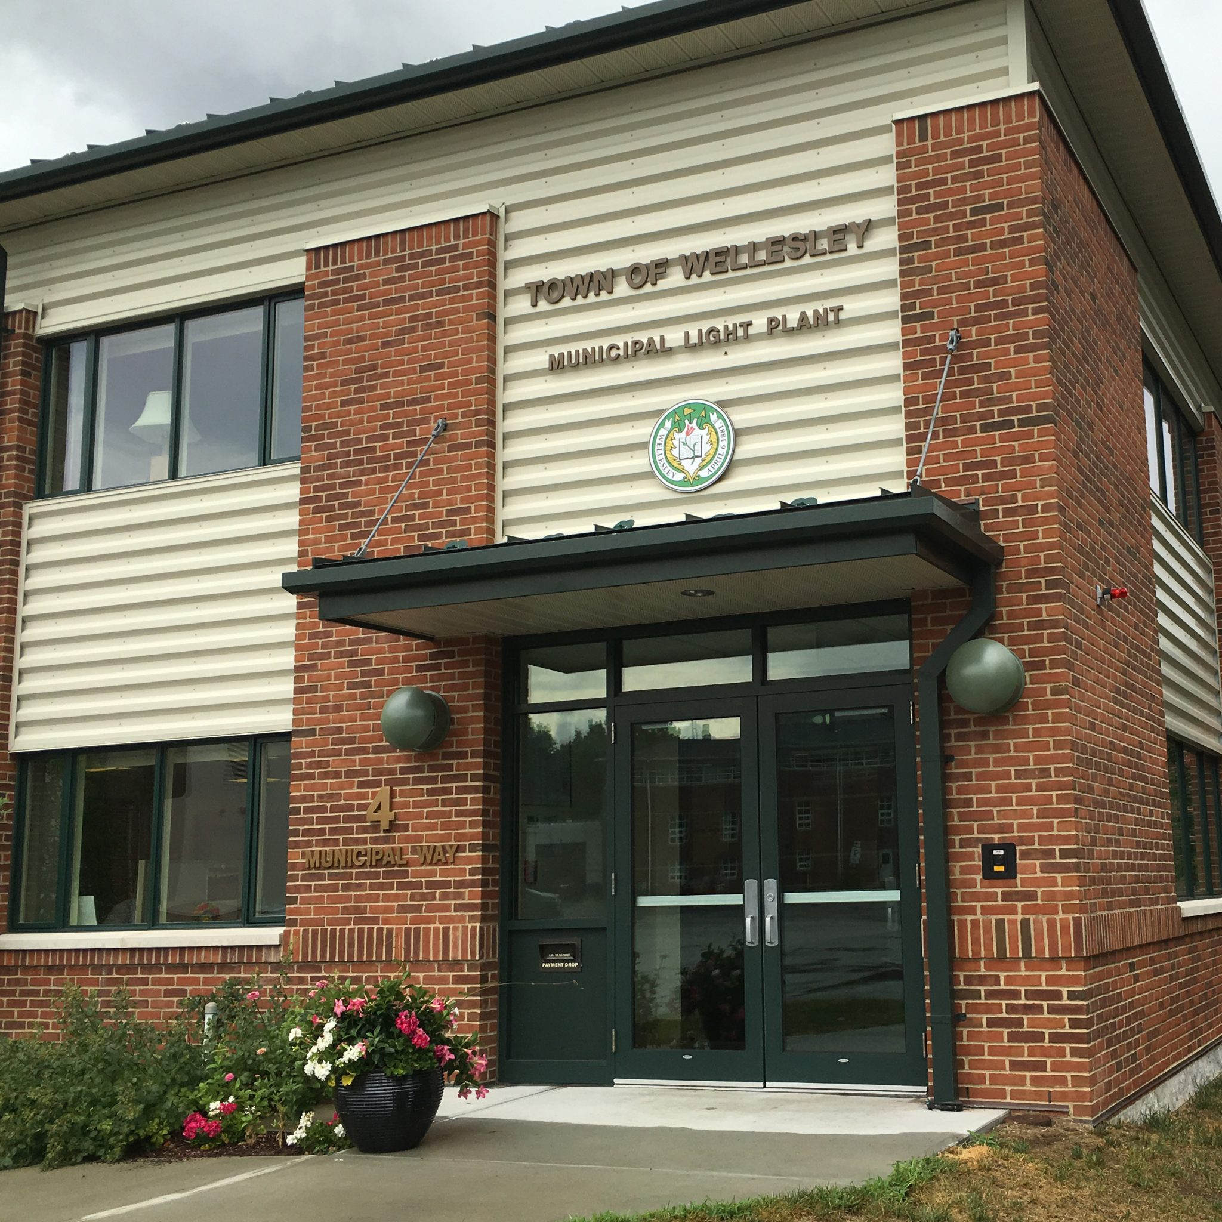
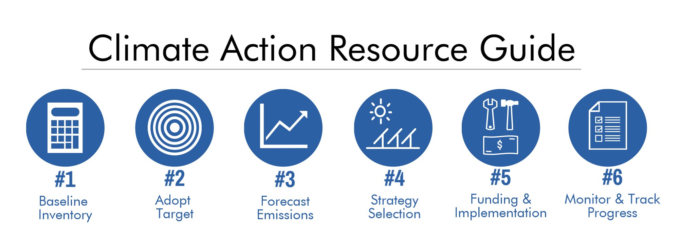
Set new GHG goals and pathways to reach these goals
Town-wide collaboration
Consultant
Capital budget request = $50,000
Possible MVP Grant

Slide 7
Climate Action Plan Focus Areas, Burlington, VT

Slide 8
Climate Action Planning
1) The town established a greenhouse gas inventory 10 years ago and, since then, has been working toward a GHG goal to reduce emissions 25% below 2007.
2) We have made excellent progress in the building sector. Transportation emissions have, however, risen about 6% since 2007.
3) The SEC is starting to develop a Climate Action Plan that will address climate change mitigation in a more inclusive and comprehensive way. The CAP process will:
Engage the municipality, community, commercial sector, and colleges;
Set new GHG emissions goals that align with the State's goals;
Include improvements in energy use data and emissions accounting; and
Identify emission reduction strategies and a timeline for meeting targets.

Slide 9

Keypad Polling

Slide 10
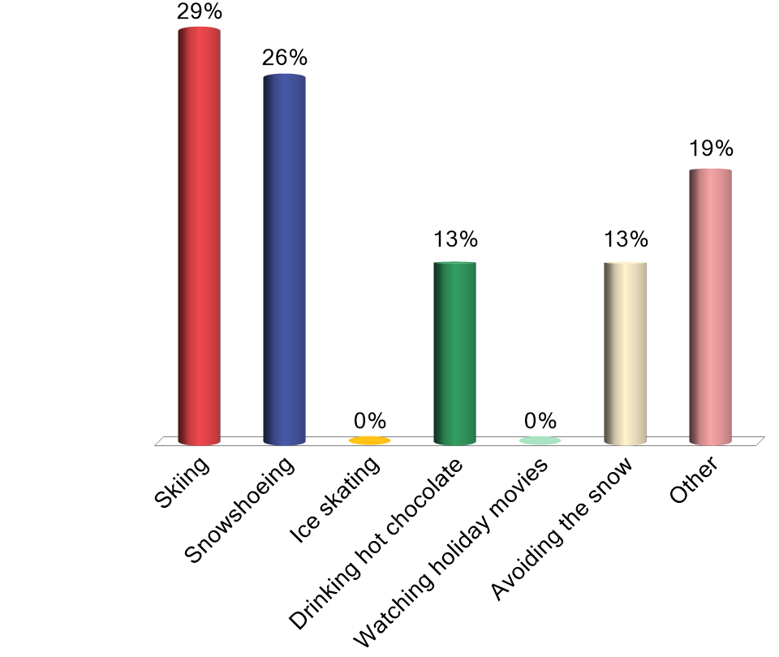
What winter activity are you most excited for?
Skiing
Snowshoeing
Ice skating
Drinking hot chocolate
Watching holiday movies
Avoiding the snow
Other

Slide 11
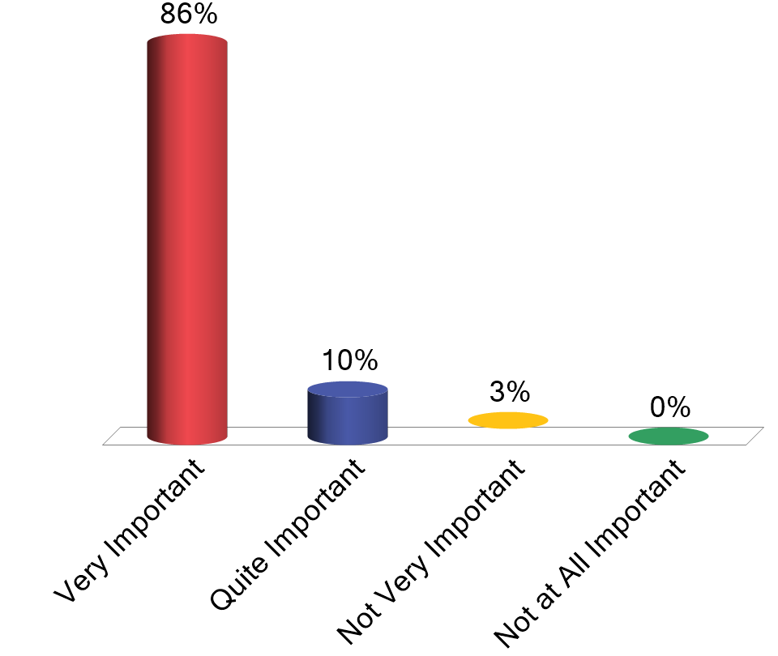
How important is the issue of climate change to you personally? Choose 1
Very Important
Quite Important
Not Very Important
Not at All Important

Slide 12
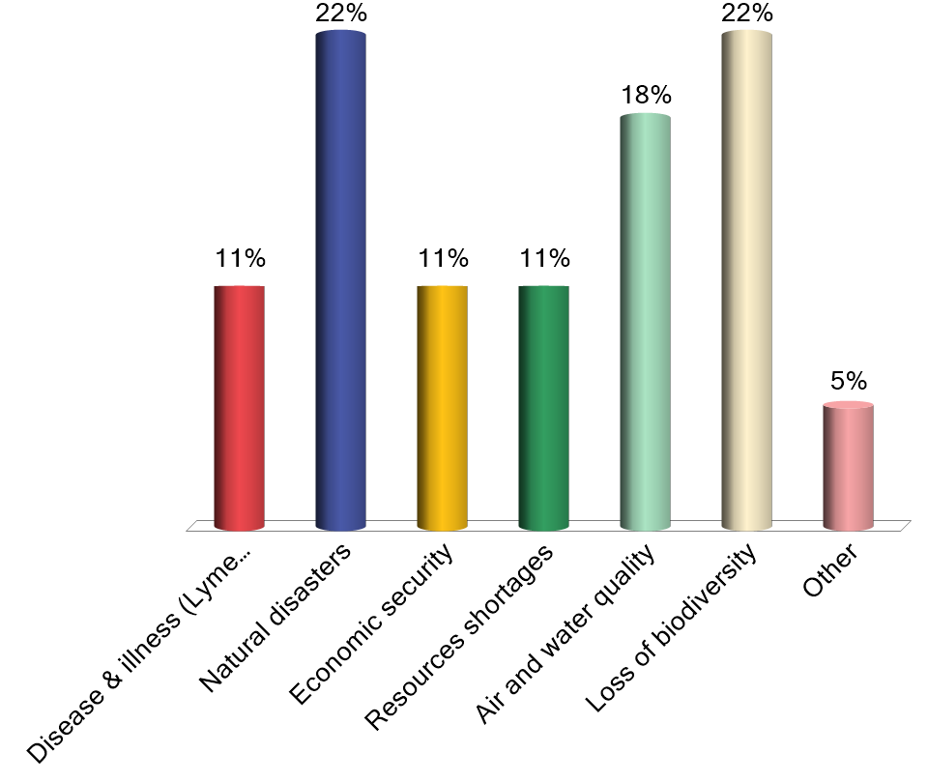
What issues are of most concern to you related to climate change? Choose 2
Disease & illness (Lyme disease, EEE, etc.)
Natural disasters
Economic security
Resources shortages
Air and water quality
Loss of biodiversity
Other

Slide 13
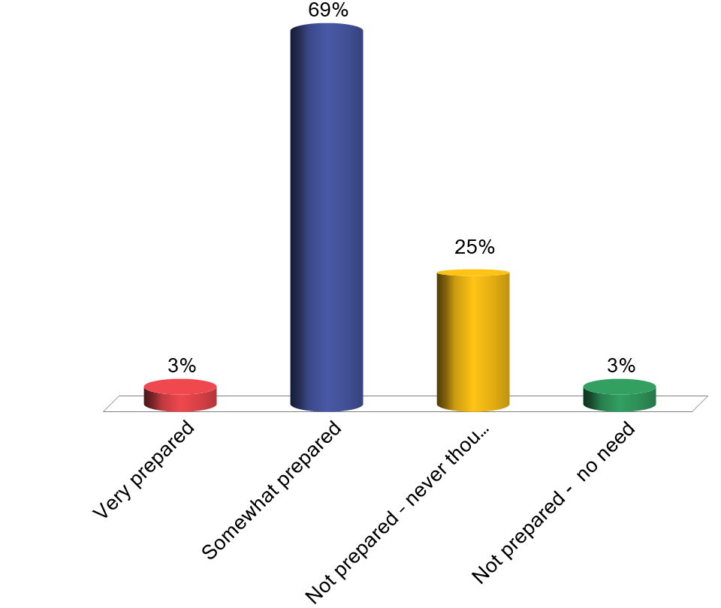
How prepared do you feel that you and/or your family are for the impacts of climate change? Choose 1
Very prepared
Somewhat prepared
Not prepared – never thought about it
Not prepared - no need

Slide 14
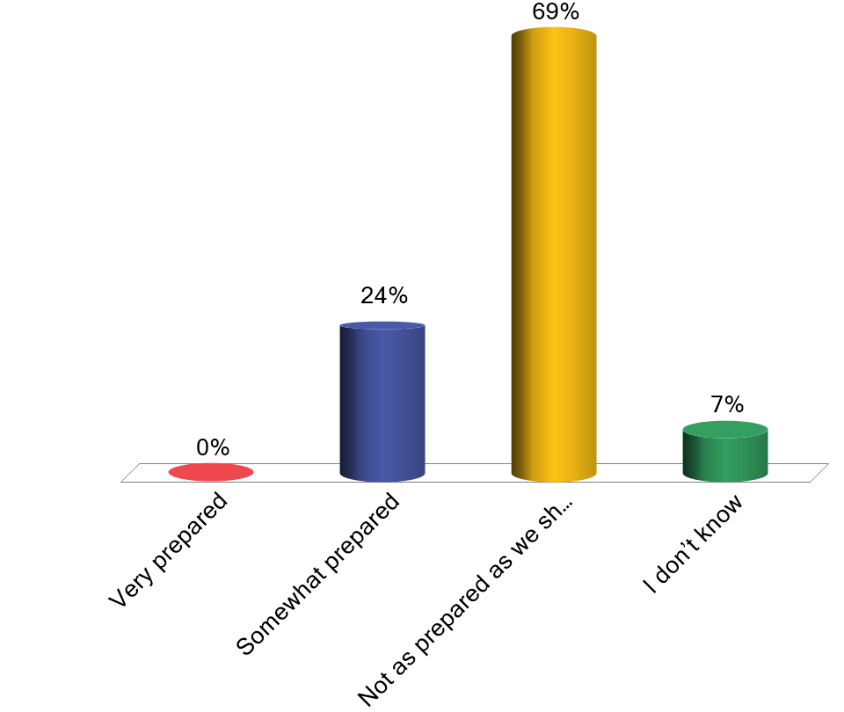
How prepared do you think the Town of Wellesley is to address the impacts of climate change? Choose 1
Very prepared
Somewhat prepared
Not as prepared as we should be
I don’t know

Slide 15
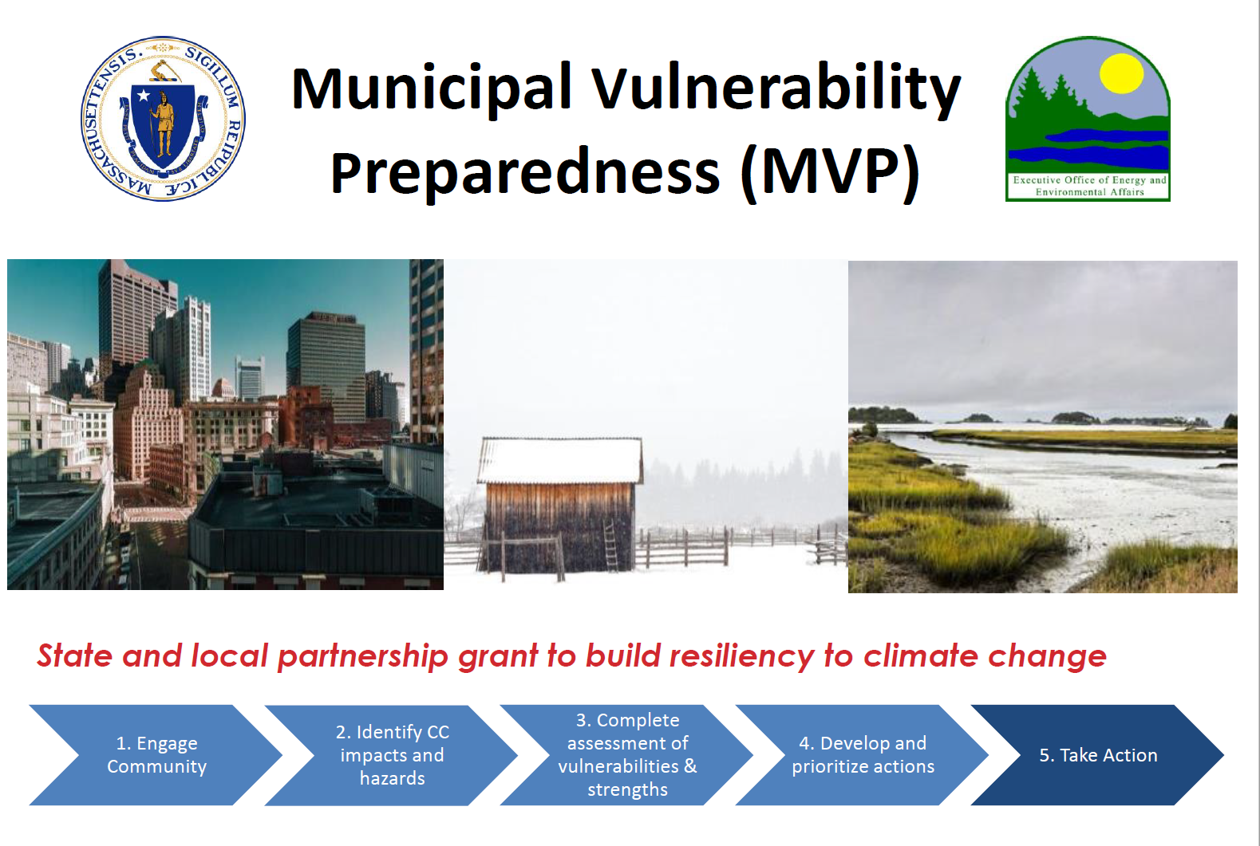

Slide 16
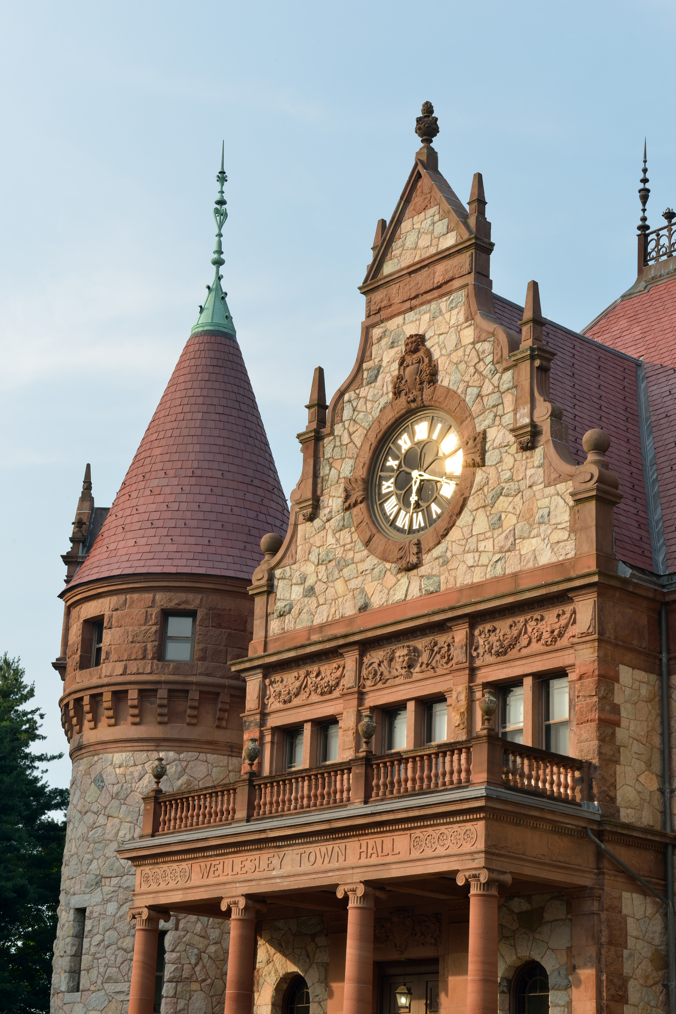
Resilience
Resilience is about surviving and thriving, regardless of the challenge. Bouncing Forward
Urban resilience is the capacity of individuals, communities, institutions, businesses, and systems within a city to survive, adapt, and grow no matter what kinds of chronic stressors and acute shocks they experience.
~100 Resilient Cities

Slide 17
Key Terms
Hazard (noun)
An event or condition caused by changes in the climate that may result in loss of life, injury, negative health impacts, or damage to property, infrastructure, services, or environmental resources.
Impact (noun)
Effects on natural and human systems caused by climate hazards.
Vulnerability (noun)
The degree to which a system is susceptible to, and unable to cope with, adverse effects of climate change.
Intense Storms (noun)
Nor'easters, ice storms, extreme precipitation, hurricanes.
Drought (noun)
A period of abnormally dry weather long enough to cause issues such as crop damage, water supply shortages, and habitat loss.
Heat Wave (noun)
For Northeast: a period of three or more consecutive days over 90°F.

Slide 18



The three changing climate conditions are…
Which lead to climate hazards…
Which in turn create impacts…
Temperature
Heat-related illnesses
More vector-borne diseases
Heat Waves
Increased risk of brushfires
Crop and habitat damage
Blocked roadways
Infrastructure damage
Power outages
Precipitation
Drought
Inland Flooding
Intense Storms
Sea Level
Coastal Flooding
Infrastructure damage
Inundated communities

Slide 19
Chronic Stressors
Financial stressors: Feeling like you aren’t making enough money to provide for yourself or your family
Social stressors: Feeling unsafe in your neighborhood due to crime, feeling alone, or other factors
Health stressors: Feeling like you can’t put your best self forward because of physical or mental health challenges
Environmental stressors: Feeling like your environment is lessening your quality of life (e.g., water quality, air pollution, lead, litter)

Slide 20
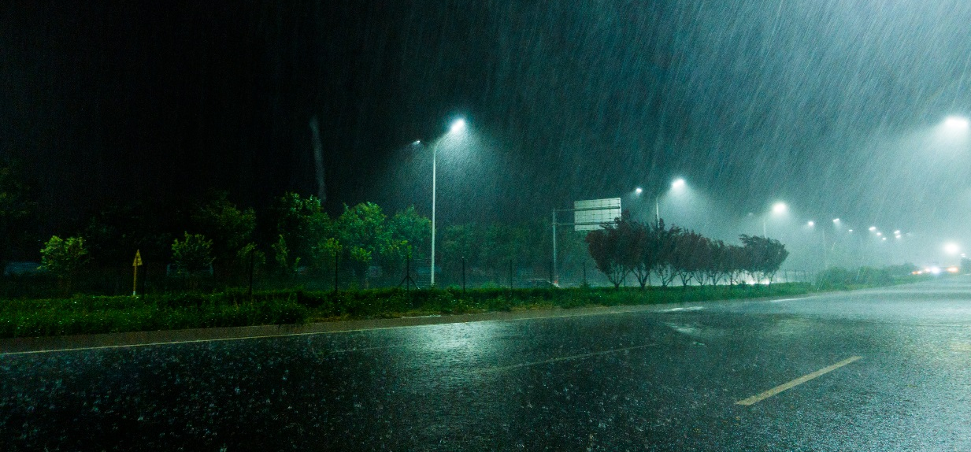
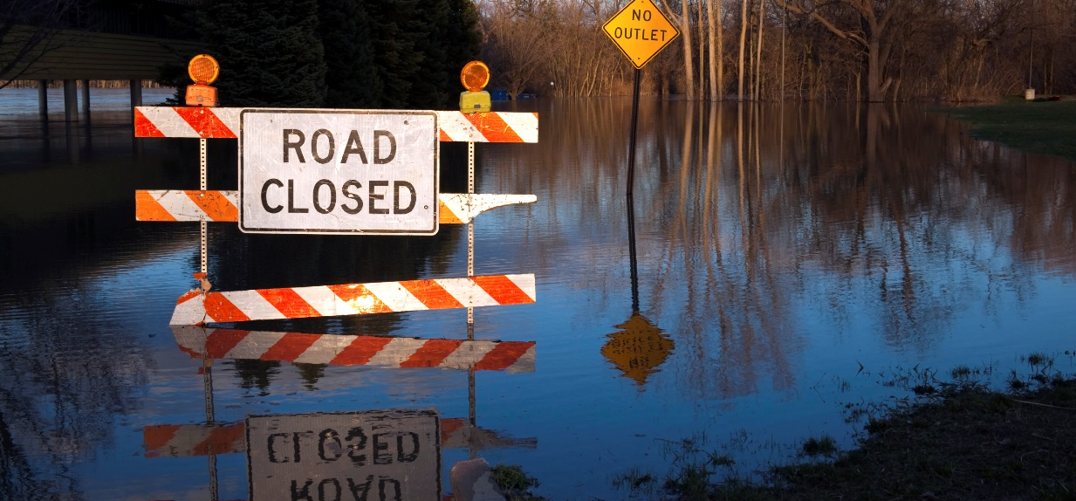
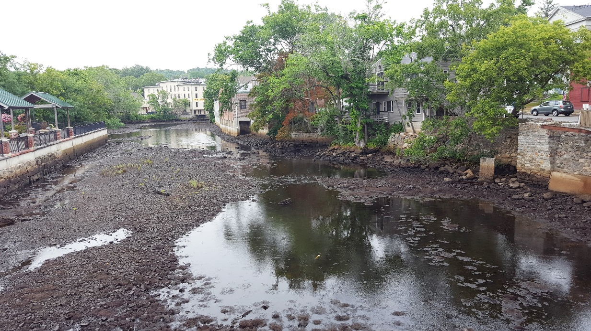
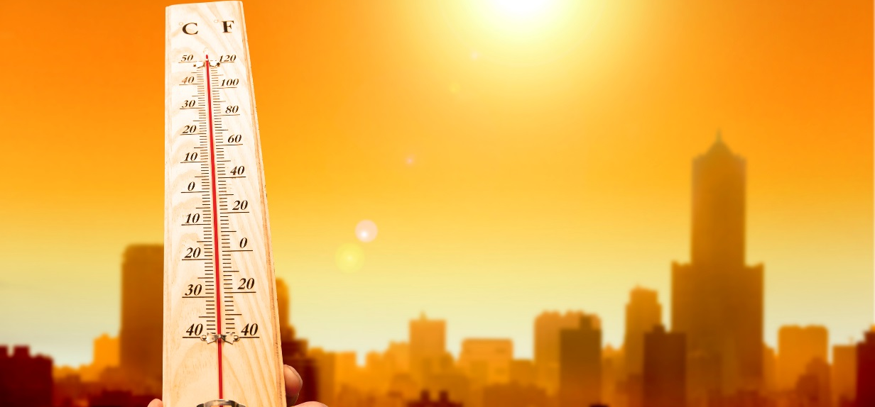
Climate Change Hazards in Wellesley

Slide 21
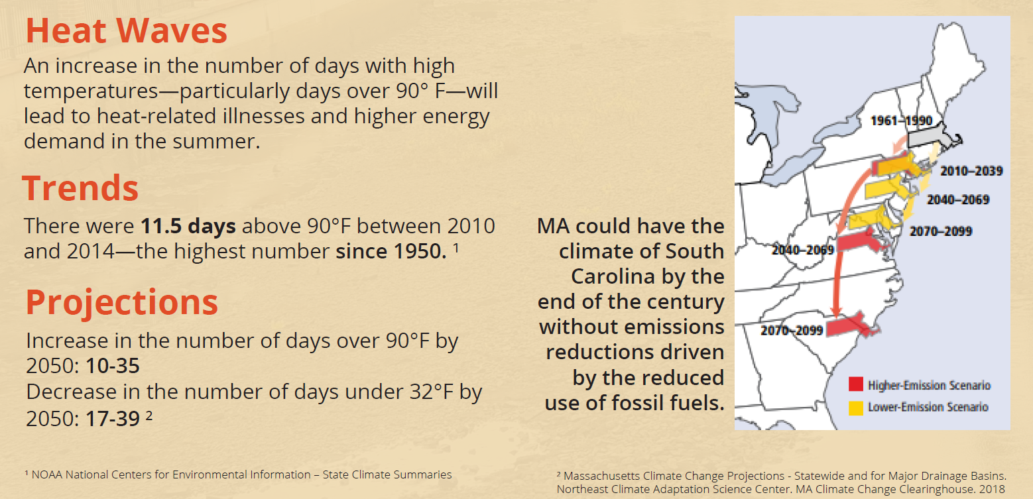
Heat Waves

Slide 22
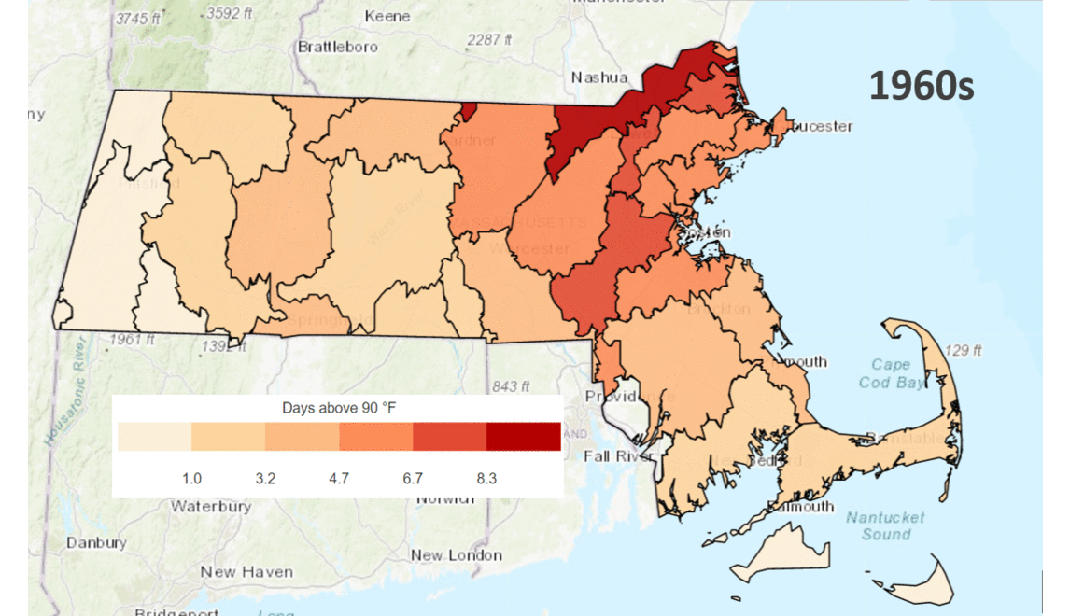
Average Annual Days Above 90º
Source: Resilient MA. Accessed 10/18/2019

Slide 23
Heat Waves: Potential Impacts in Wellesley
Heat-related illnesses for those without air conditioning
More favorable climate for invasive species
Increased AC use could cause brown-outs

Slide 24
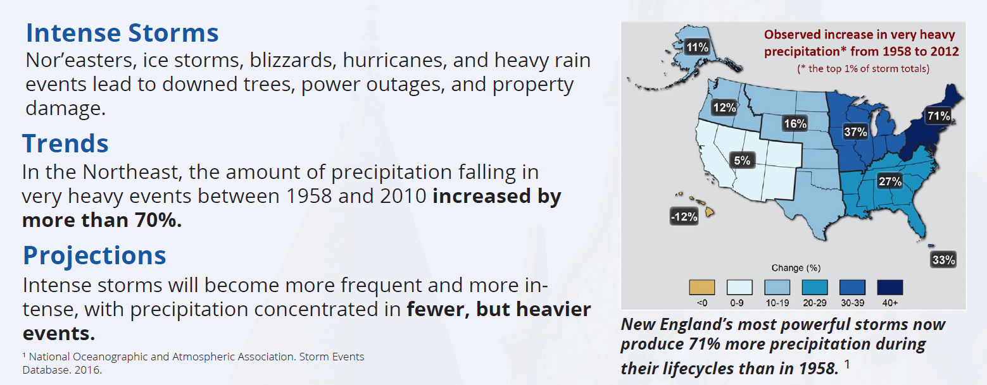
Intense Storms

Slide 25

Intense Storms: Potential Impacts in Wellesley
Impacts to critical facilities, utilities, communications
Power outages
Restricted communication channels

Slide 26
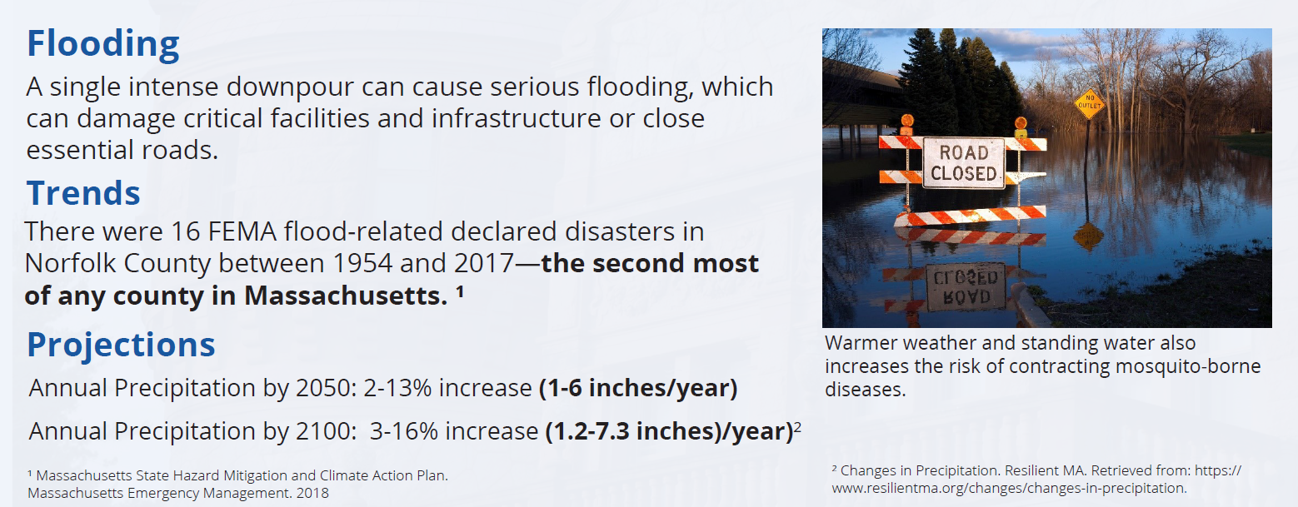
Flooding

Slide 27
Flooding: Potential Impacts in Wellesley
Damage to buildings in floodplain
Larger mosquito populations from standing water
Contamination flowing into waterways

Slide 28
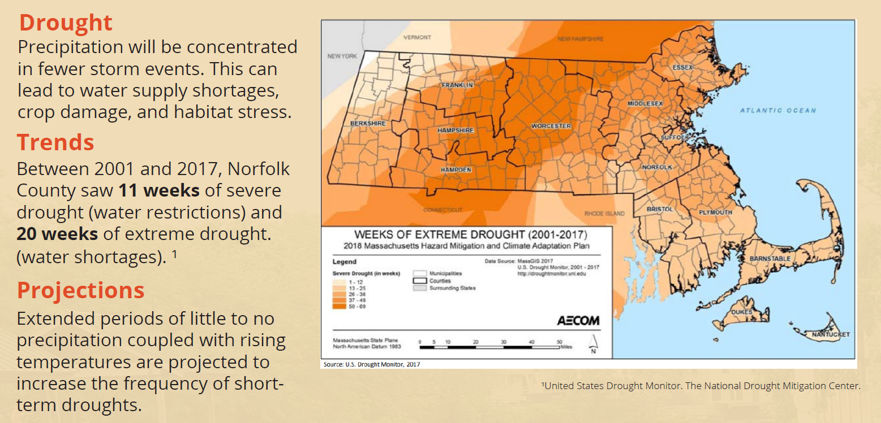
Drought

Slide 29

Drought: Potential Impacts in Wellesley
Increasing food costs
Damage to wildlife habitat
Higher risk of brushfire

Slide 30
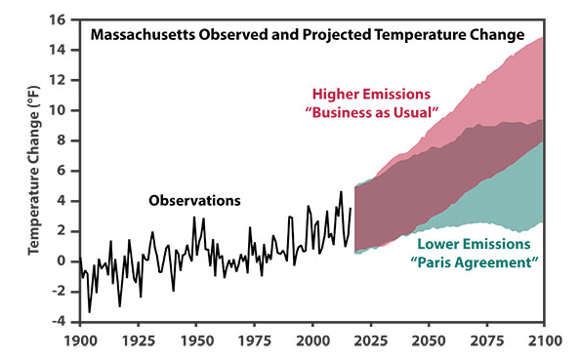
Reducing GHGs Matters, too

Slide 31
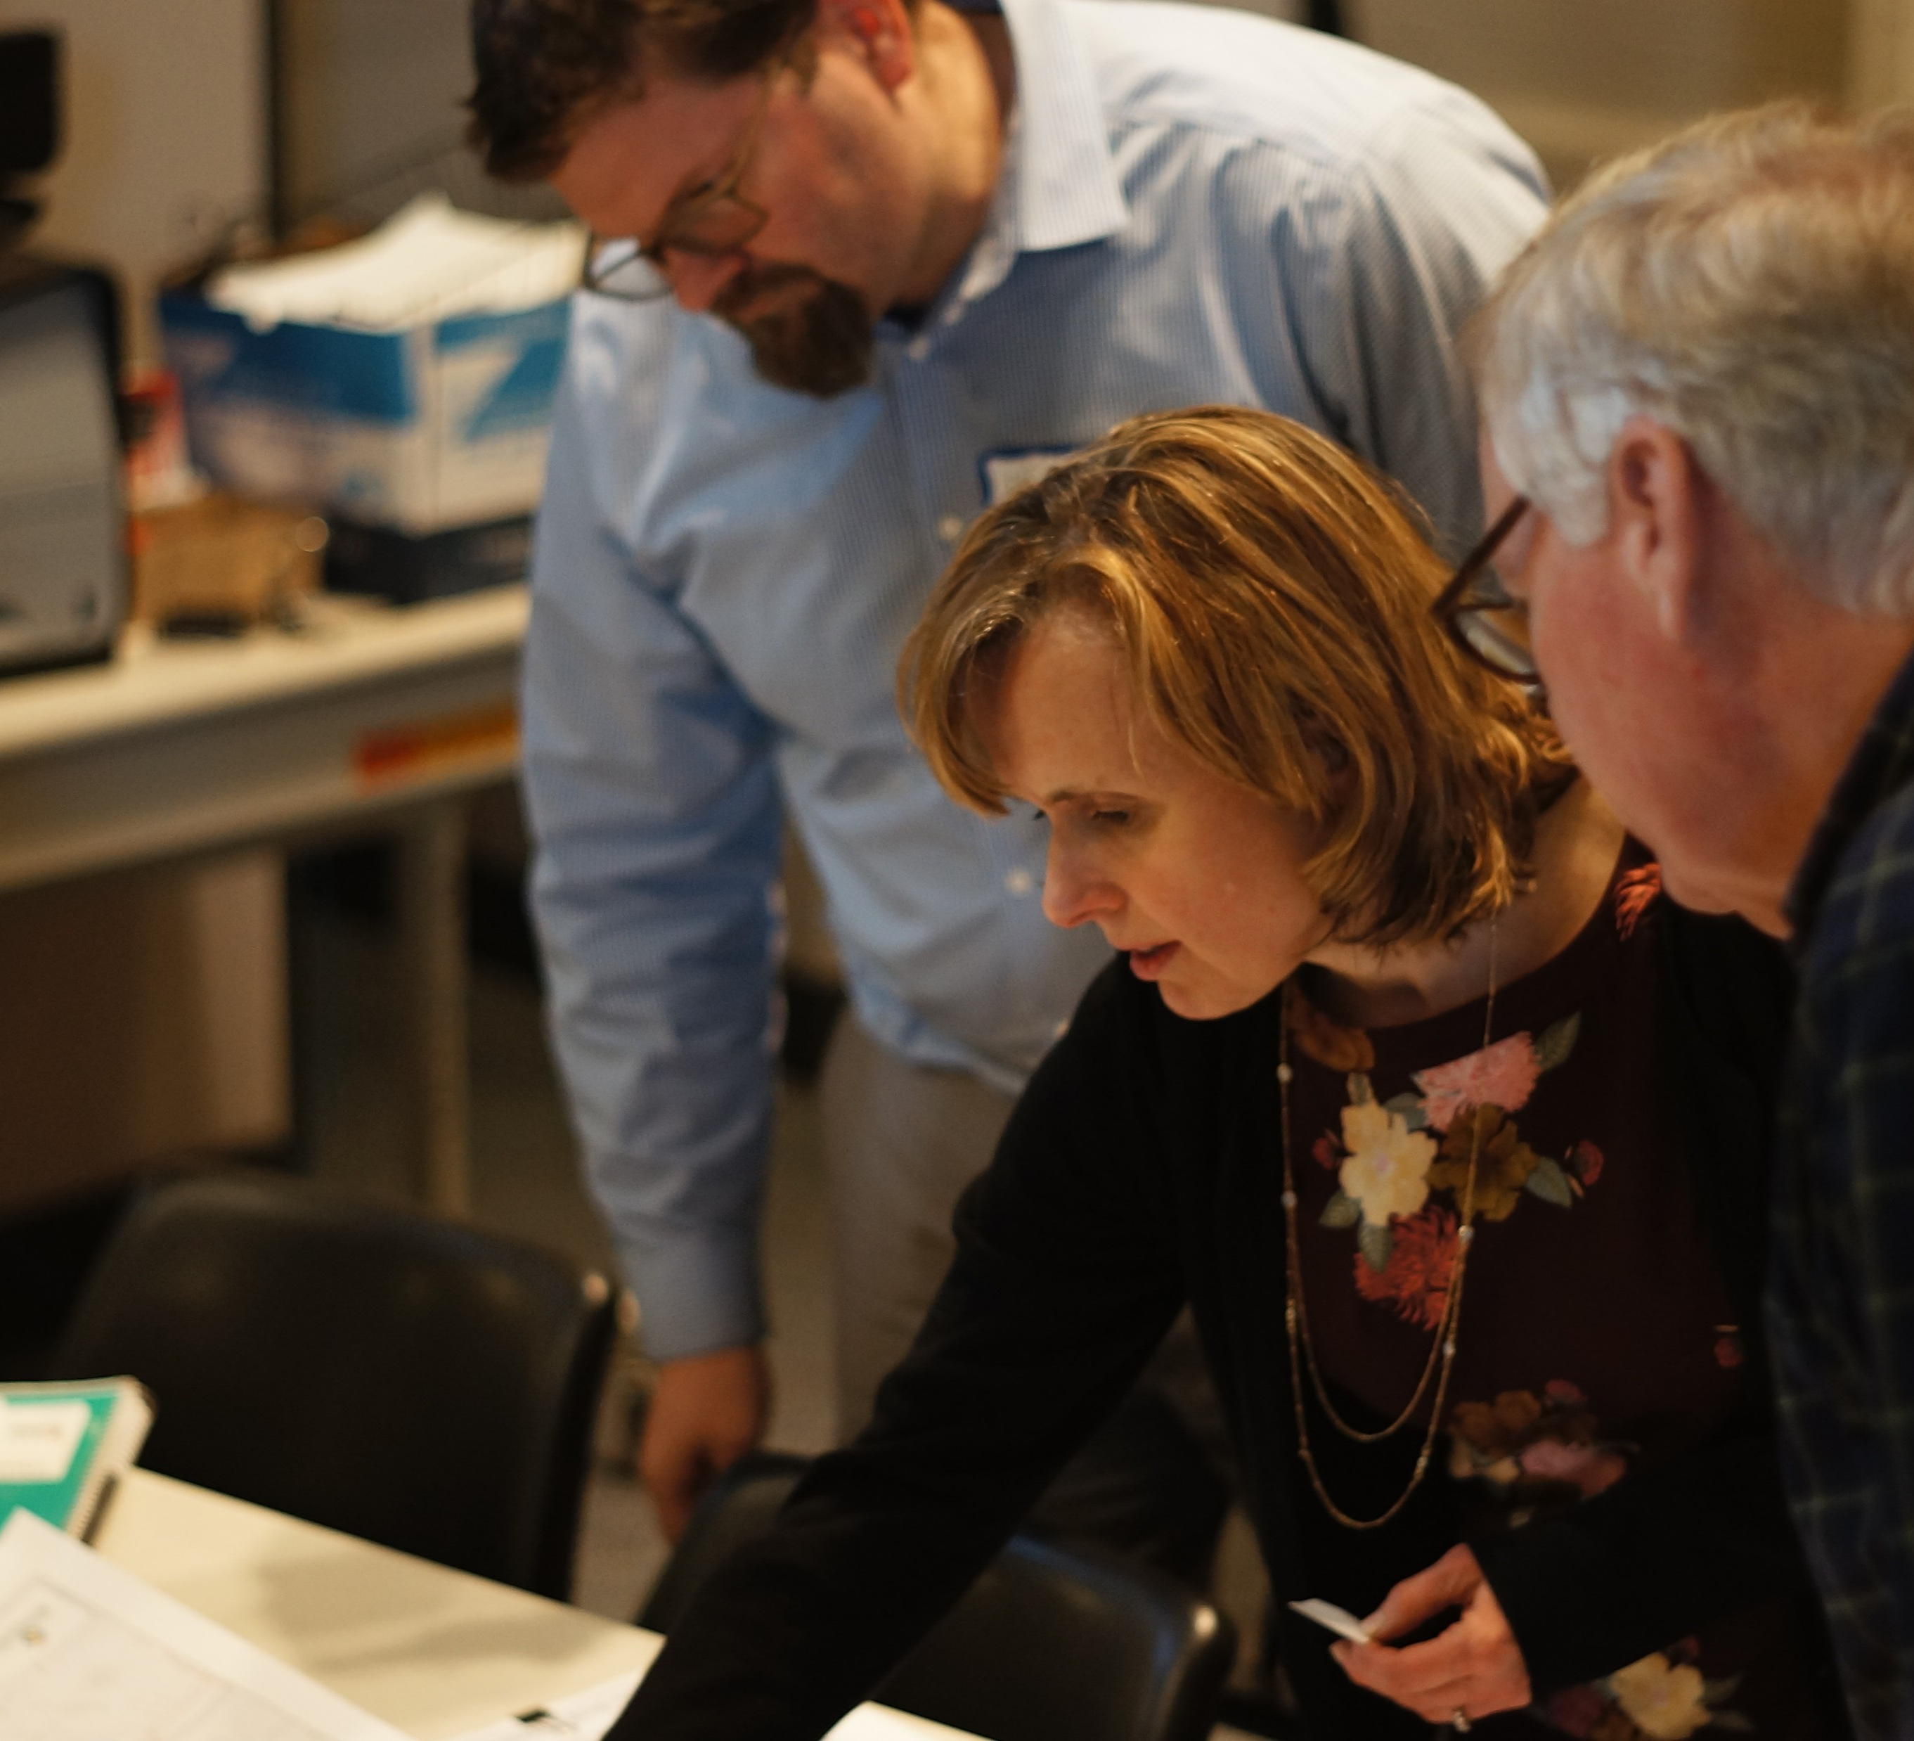
Takeaways from MVP Workshops

Slide 32
Category Themes
Infrastructure Themes: Power security, communication systems, drainage and water systems, limited public transportation system
Environmental Themes: protection of tree canopy, wetlands, and watershed; increasing the use of parks and open space; biodiversity and invasive/native plants
Socio-Economic Themes: vulnerability of the elderly, housing security of municipal staff, businesses in floodplain, pockets of food insecurity, resilient communication system

Slide 33
Top Actions from MVP Workshops
Infrastructure
Social and Economic
Environmental
Work with MassDOT on addressing Rt. 9 culvert and ongoing stormwater maintenance
More solar with battery back-up
Feasibility assessment for microgrids
Identify locations of gas shut off valves and improving maintenance
Emergency preparedness campaign
Unified communication strategy that leverages diverse channels and existing organizations
Commuter and walking connections to schools
Transit improvements around school and rail
Implement a sustainable landscaping program
Promote pocket parks/popup parks with built in education
Refine Tree Protection Bylaw to incentivize further protection

Slide 34
Final Report
Community Workshops
Public Listening Session

Slide 35
Open House Discussions at Hazard Stations
** Recommended 15 minutes each station**
Intense Storms
Heat Waves
Flooding
Drought
Notes:
You’ll now have a chance to travel to each of four stations representing the different hazards discussed through the MVP workshops. There will be a poster with historical trends and projections and a facilitator who can help answer any questions and guide the conversation. You’ll use sticky notes to answer the three questions at the bottom of each poster:
What concerns you most about this hazard?
What could be done to help community members be better prepared for this hazard?
What actions have you already taken or would you be willing to take to better protect yourself from this hazard?
After about 15 minutes we will prompt you to transition to the next station.

Slide 36
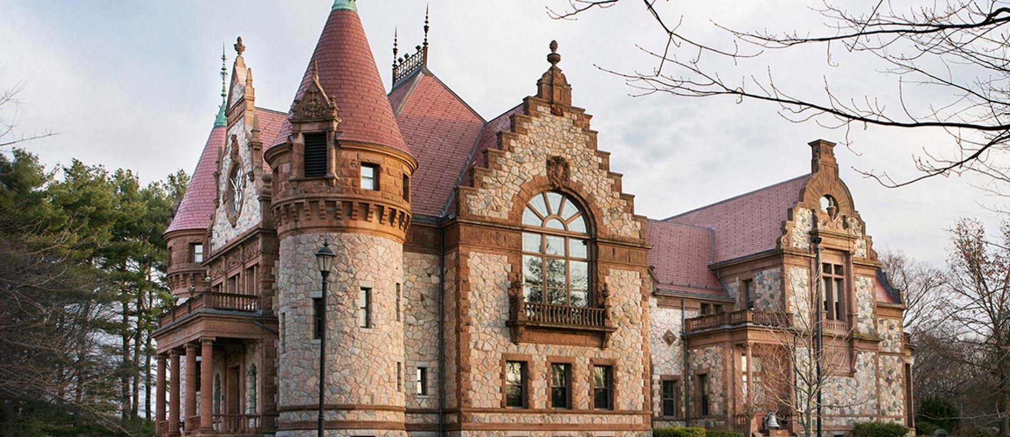

Thank you!

